Slide 1
Mobile Computing
Unit 1 : Introduction

Slide 2
Outline
Overview of Wireless and Mobile Infrastructure
Preliminary Concepts
Design Objectives and Performance Issues
Radio resource Management
Propagation and Path Loss Models
Channel Interference and Frequency Reuse
Cell Splitting
Channel Assignment
Overview of Generations

Slide 3
Why Mobile Computing?
Mobile refers to access in motion, no restriction on geographic location.
With mobility comes lot of issues, techniques and solutions.
80% of the world’s workforce is mobile.
The demand for mobile communication creates the need for integration of wireless networks into existing fixed networks
Notes:
Fixed Networks: LAN IEEE 802.11, Mobile Extension for Internet protocol(IP)

Slide 4
Importance of Mobile Communication
Location Flexibility
This has enabled users to work from anywhere as long as there is a connection established. A user can work without being in a fixed position.
Saves Time
The time consumed or wasted while travelling from different locations or to the office and back, has been slashed
Enhanced Productivity
Users can work efficiently and effectively from whichever location they find comfortable. This in turn enhances their productivity level.
Ease of Research
Research has been made easier, since users earlier were required to go to the field and search for facts and feed them back into the system.
Entertainment
Business processes are now easily available

Slide 5
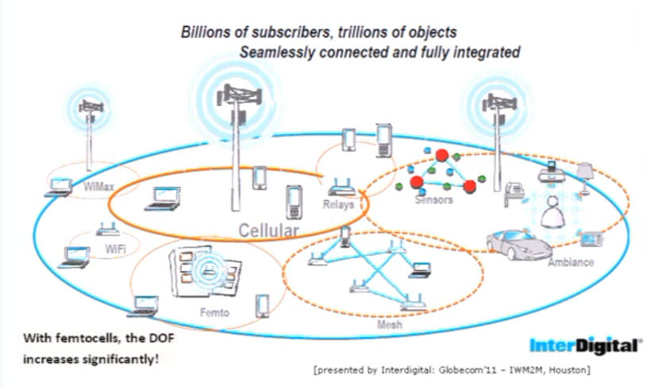
Heterogeneous
Notes:
femtocell is a small, low-power cellular base station, typically designed for use in a home or small business
SON, or self-organizing networks, use software to help operators automate network functions and control equipment.

Slide 6
Applications
Vehicles
transmission of news, road condition, weather, music via DAB
personal communication using GSM
position via GPS
local ad-hoc network with vehicles close-by to prevent accidents, guidance system, redundancy
vehicle data (e.g., from busses, high-speed trains) can be transmitted in advance for maintenance
Emergencies
early transmission of patient data to the hospital, current status, first diagnosis
replacement of a fixed infrastructure in case of earthquakes, hurricanes, fire etc.
Disaster Management like crisis, floods, pandemic, ...
Notes:
DAB: Digital Audio Broadcasting, GSM – Global System for Mobile communication , GPS: Global Positioning system

Slide 7
Applications
Travelling salesmen
direct access to customer files stored in a central location
consistent databases for all agents
mobile office
Replacement of fixed networks
remote sensors, e.g., weather, earth activities
flexibility for trade shows
LANs in historic buildings
Entertainment, education, ...
outdoor Internet access
intelligent travel guide with up-to-date location dependent information
ad-hoc networks for multi user games

Slide 8
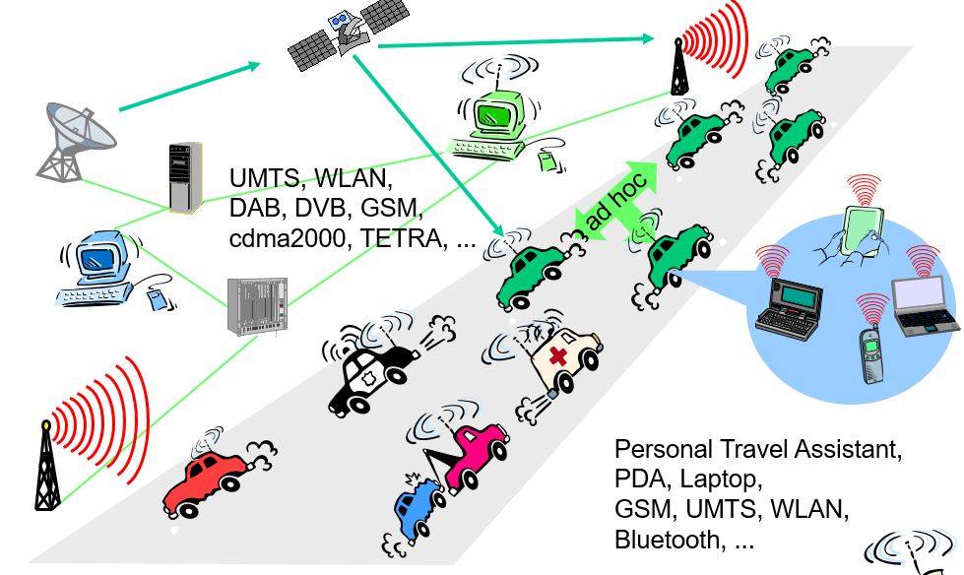
Example : Road Traffic Monitoring
Notes:
GSM – Global System for Mobile communication (Adhoc is a decentralized type of network, No pre installed infrastructure required)
DAB : Digital Audio Broadcasting (DAB v/s FM) (Not in India, AIR is taking an initiative to change it) Private FM firms are not into it.

Slide 9
Services Provided
Location aware services
what services, e.g., printer, fax, phone, server etc. exist in the local environment
Follow-on services
automatic call-forwarding, transmission of the actual workspace to the current location
Information services
„push“: e.g., current special offers in the supermarket
„pull“: e.g., where is the Black Forrest Cherry Cake?
Support services
caches, intermediate results, state information etc. „follow“ the mobile device through the fixed network
Privacy
who should gain knowledge about the location

Slide 10
Design Objectives of Mobile Computing
Type of Application (Native or Mobile Web) : Before designing mobile application you need to determine type of application. ...
Target device
User experience
Resource Constraint
Multiple Platforms
Security
Network Communication

Slide 11
Issues in Mobile Computing
Security, secrecy, and privacy
Resource and spectrum utilizations
Communication infrastructure
Energy efficiency enhancement
Integration of wireless information and power transfer
Wireless access techniques
Dynamic architecture and network functions analysis
Coding and modulation
Resource and interference management
https://www.frontiersin.org/articles/10.3389/frcmn.2020.00001/full

Slide 12
Different types of Mobile Networks
GSM : Global System for Mobile communication
(2G, 900MHz, 1900MHz Bands)
LTE - Long Term Evolution
(4G , for GSM 700, 750, 800 , 850 , 1800 , 1900 , 2100 , 2600 MHz
HSDPA - High Speed Downlink Packet Access
Advanced to 3G ,3.5 G
EV-DO – Evolution Data-Only.
It mainly runs on CDMA Networks for 3G
CDMA – Code Division Multiple Access
(3G Wireless, 450,800,1900MHz Bands)
UMTS – Universal Mobile Telecommunications System
(3G Technology WCDMA)
HSUPA – High Speed Uplink Packet Access
Notes:
Tata Docomo CDMA (Previously called as Tata Indicom), Reliance CDMA and BSNL etc.

Slide 13
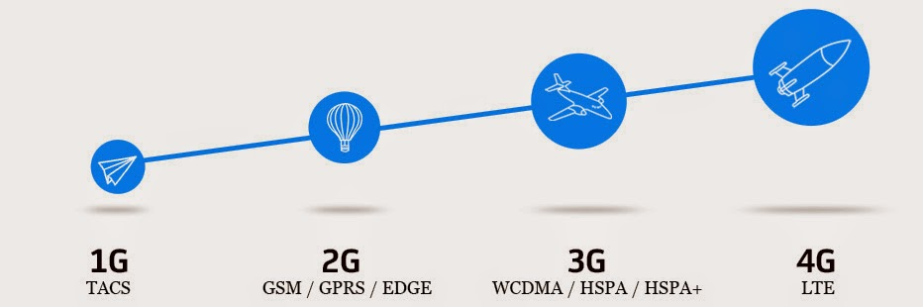
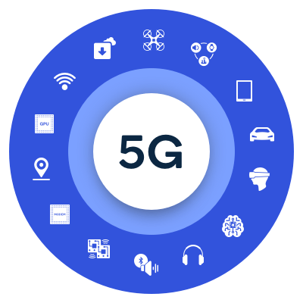
Types of Mobile Network
Designed to connect virtually everyone and everything together including machines, objects, and devices.
Deliver higher multi-Gbps peak data speeds

Slide 14
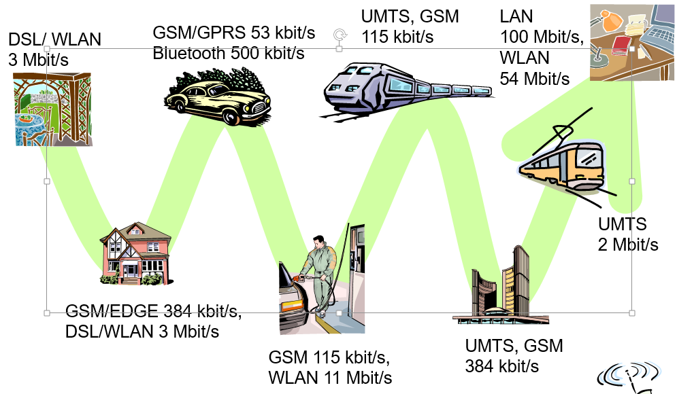
Mobile and Wireless Services
http://www.jochenschiller.de/ MC SS05 1.1

Slide 15
Two Aspects of Mobility
User Mobility
User mobility refers to a user who has access to the same or similar telecommunication services at different places, i.e., the user can be mobile, and the services will follow.
Device Portability
Device portability refers to the communication device moves (with or without a user). Many mechanisms in the network and inside the device have to make sure that communication is still possible while the device is moving. E.g; Mobile Phone System
Wireless V/s Mobile Examples 🗶 🗶 stationary computer 🗶 ✔ notebook in a hotel ✔ 🗶 wireless LANs in historic buildings ✔ ✔ Personal Digital Assistant (PDA)
Notes:
It is impossible to create a great experience without three ingredients. We will concentrate on third ingredient in the video.

Slide 16
Effects of device Portability
Power consumption
limited computing power, low quality displays, small disks due to limited battery capacity
CPU: power consumption ~ CV²f
C: internal capacity, reduced by integration
V: supply voltage, can be reduced to a certain limit
f: clock frequency, can be reduced temporally
Loss of data
higher probability, has to be included in advance into the design (e.g., defects, theft)
Limited user interfaces
compromise between size of fingers and portability
integration of character/voice recognition, abstract symbols
Limited memory
limited value of mass memories with moving parts
flash-memory or ? as alternative

Slide 17
Wireless Networks in comparison with Fixed Networks
Higher loss-rates due to interference
emissions of, e.g., engines, lightning
Restrictive regulations of frequencies
frequencies have to be coordinated, useful frequencies are almost all occupied
Low transmission rates
local some Mbit/s, regional currently, e.g., 53kbit/s with GSM/GPRS
Higher delays, higher jitter
connection setup time with GSM in the second range, several hundred milliseconds for other wireless systems
Lower security, simpler active attacking
radio interface accessible for everyone, base station can be simulated, thus attracting calls from mobile phones
Always shared medium
secure access mechanisms important

Slide 18
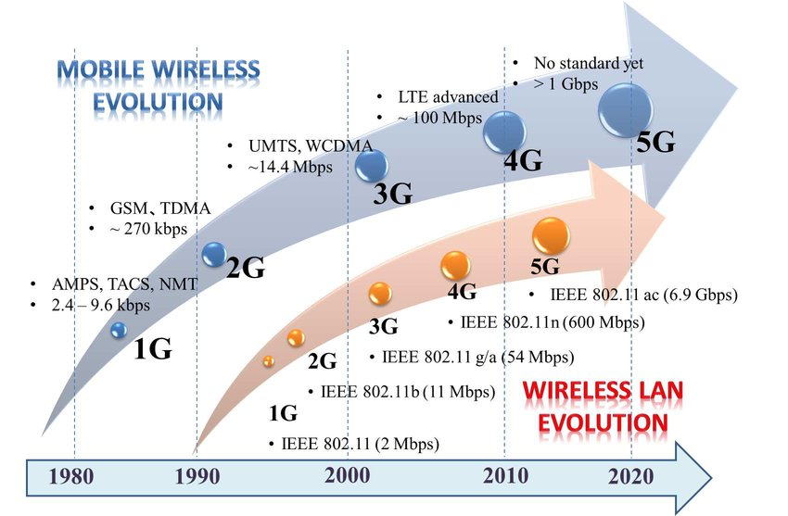
History of Telecommunication

Slide 19
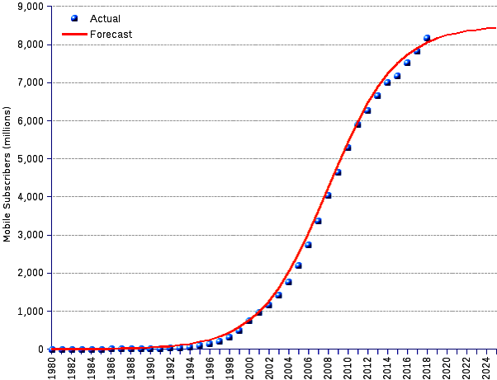
Cellular Subscribers World Wide

Slide 20
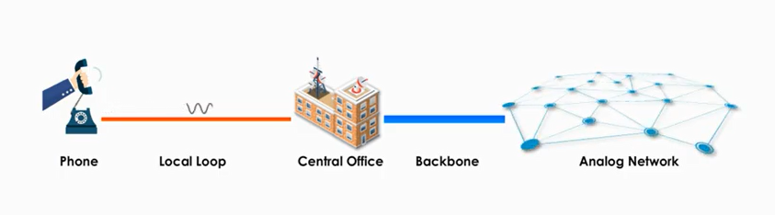
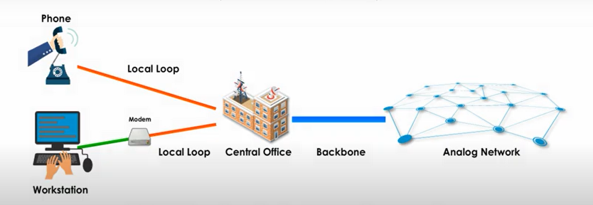
Common Services in Communication PSTN
USE of Analog Signals only
Notes:
Modems were used for computers for using existing PSTN networks (Public Switched Telephone Network )
Drawbacks of analog signals: Over long distance cannot maintain high quality, carry less information

Slide 21
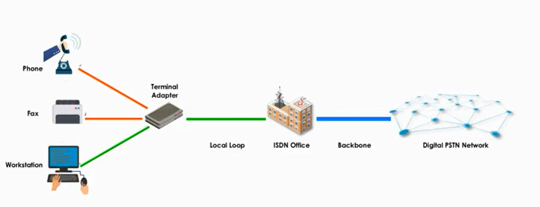
ISDN
Digital network to transmit voice, image, video and text over circuit switched PSTN
Notes:
ISDN terminal adapter is used to convert data into isdn format. (Integrated Services Digital Network )

Slide 22
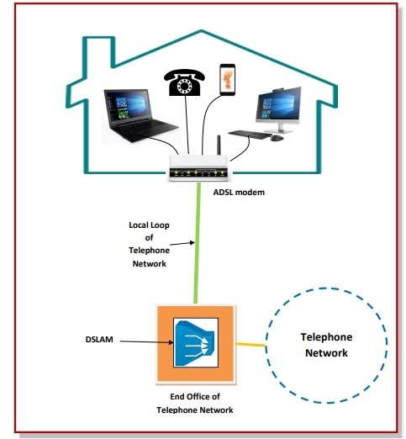
ADSL: Asymmetric Digital Subscriber line
Type of Broadband internet connection.
ADSL uses analog sinusoidal carrier waves for data transmission. The waves are modulated and demodulated at the customer premises with ADSL modems.

Slide 23
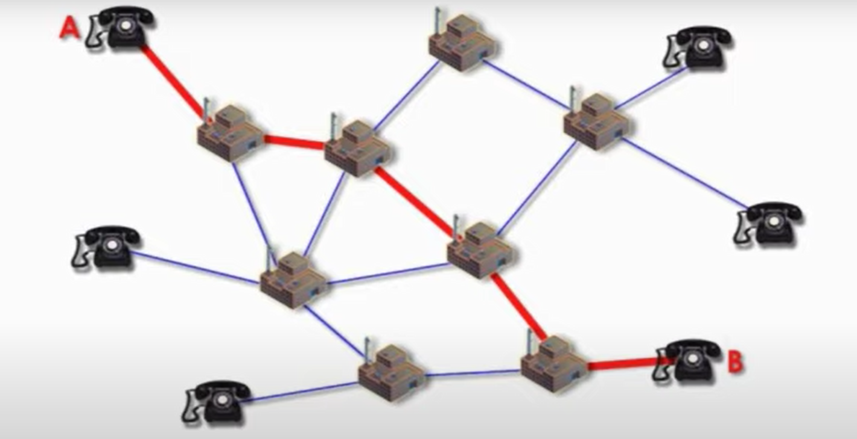
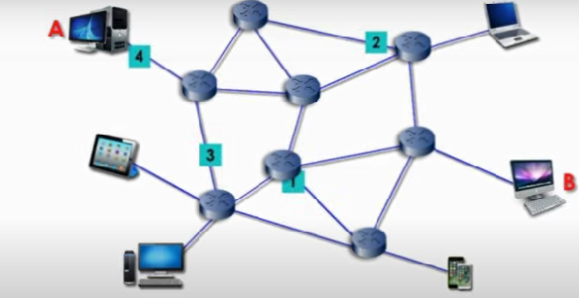
Circuit Switched V/S Packet switched
Circuit Switched Network
Packet Switched Network
Notes:
Dedicated Channel once the connection is established in circuit switched.
Data is broken into packets and each packet is transferred over various available routes. Protocol (TCP/IP) Packets are assembled at the destination.

Slide 24
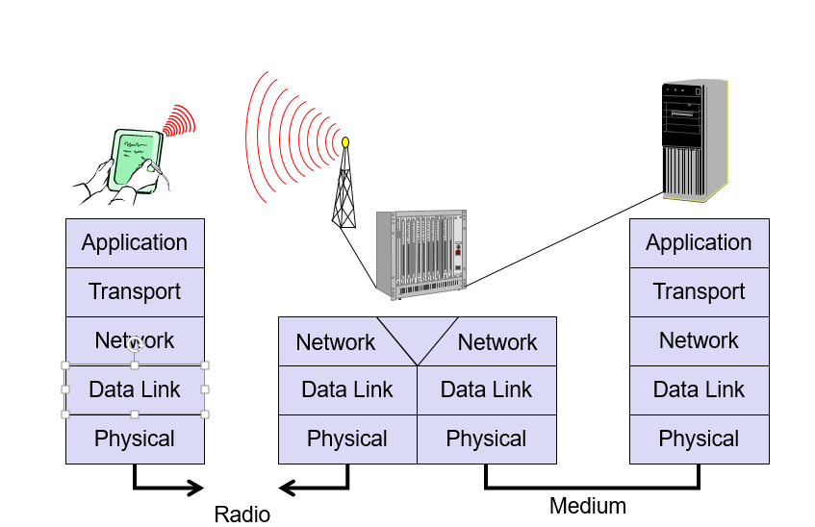
Simple Reference Model

Slide 25
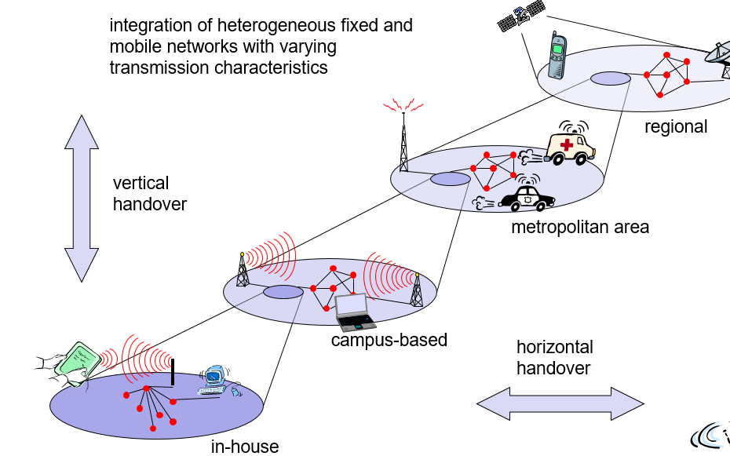
Overlay Networks: Global Goal

Slide 26
Radio resource management (RRM)
System level management of co-channel interference, Radio resources, and other radio transmission characteristics in wireless communication systems.
Cellular networks, wireless local area networks, wireless sensor systems, and radio broadcasting networks.
Notes:
In telecommunications in general, a channel is a separate path through which signals can flow.

Slide 27
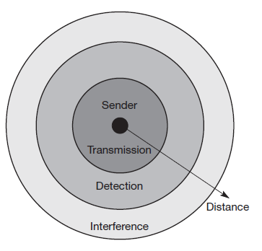
Signal Propagation
Transmission range: Within a certain radius of the sender transmission is possible, i.e., a receiver receives the signals with an error rate low enough to be able to communicate and can also act as sender.
● Detection range: Within a second radius, detection of the transmission is possible, i.e., the transmitted power is large enough to differ from background noise. However, the error rate is too high to
● Interference range: Within a third even larger radius, the sender may interfere with other transmission by adding to the background noise. A receiver will not be able to detect the signals, but the signals may disturb other signals.

Slide 28
Path loss of radio signals
In free space radio signals propagate as light.
If such a straight line exists between a sender and a receiver it is called line-of-sight (LOS).
signal still experiences the free space loss even in vacuum
Received power Pr is proportional to 1/d2 with d being the distance between sender and receiver. (inverse square law).
radio transmission takes place through the atmosphere – signals travel through air, rain, snow, fog, dust particles, smog etc.
While the path loss or attenuation does not cause too much trouble for short distances, the atmosphere heavily influences transmission over long distances.
Notes:
the sender being a point in space. The sender now emits a signal with certain
energy. This signal travels away from the sender at the speed of light as a wave
with a spherical shape. If there is no obstacle, the sphere continuously grows with the sending energy equally distributed over the sphere’s surface.
This surface area s grows with the increasing distance d from the center according to the equation s = 4π d2.

Slide 29
Radio Waves : Three Fundamental Propagations
Ground wave (<2 MHz): Waves with low frequencies follow the earth’s surface and can propagate long distances. These waves are used for, e.g., submarine communication or AM radio.
Sky wave (2–30 MHz): Many international broadcasts and amateur radio use these short waves that are reflected2 at the ionosphere. This way the waves can bounce back and forth between the ionosphere and the earth’s surface, travelling around the world.
Line-of-sight (>30 MHz): Mobile phone systems, satellite systems, cordless telephones etc. use even higher frequencies.

Slide 30
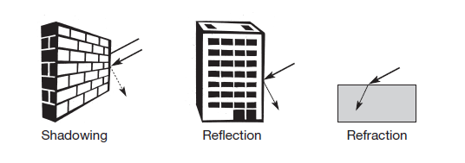
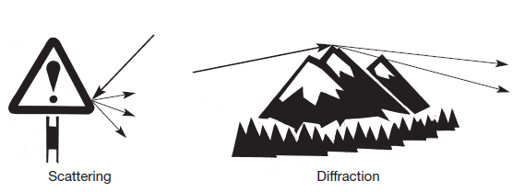
Effects of Signal Propagation
Notes:
Shadowing also called blocking :Even small obstacles like a simple wall, a truck on the street, or trees in an alley may block the signal.
Effects like attenuation, scattering, diffraction, and refraction all happen simultaneously and are frequency and time dependent

Slide 31
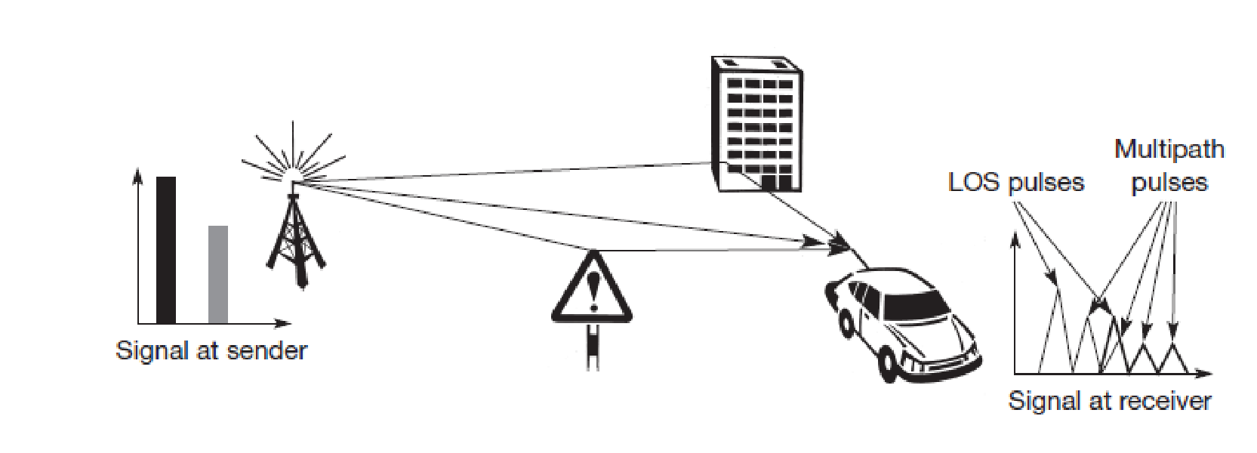
Multipath Propagation
Delay spread: the original signal is spread due to different delays of parts of the signal
Typical values for delay spread are approximately 3 μs in cities, up to 12 μs can be observed. GSM, for example, can tolerate up to 16 μs of delay spread, i.e., almost a 5 km path difference.

Slide 32
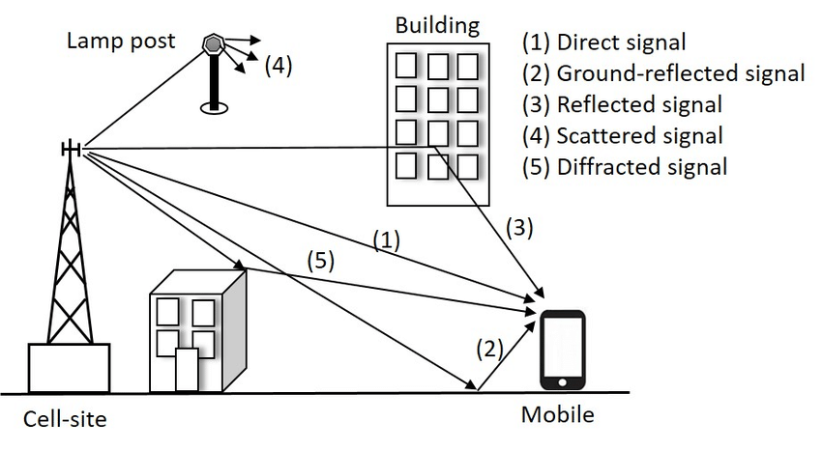
Multipath Propagation
Notes:
most severe radio channel impairments, called multi-path propagation. delay spread: the original signal is spread due
to different delays of parts of the signal

Slide 33
Effects of Delay Spread
Short impulse will be smeared out into a broader impulse, or rather into several weaker impulses.
At the receiver, both impulses interfere, i.e., they overlap in time. The energy intended for one symbol now spills over to the adjacent symbol, an effect which is called inter-symbol interference (ISI).
ISI limits the bandwidth of a radio channel with multi-path
propagation.
Avoid ISI:
1. Channel characteristics should be known.
2. Sender may first transmit a training sequence known by the receiver. The receiver then compares the received signal to the original training sequence.
3. Programs an equalizer that compensates for the distortion.
Notes:
Due to this interference, the signals of different symbols can cancel each other out leading to misinterpretations at the receiver and causing transmission errors.

Slide 34
Effects of Signal Propagation
ISI and delay spread already occur in the case of fixed radio transmitters and receivers, the situation is even worse if receivers, or senders, or both, move.
Fading
The power of the received signal changes considerably over time. These quick changes in the received power are also called short-term fading.
Depending on the different paths the signals take, these signals may have a different phase and cancel each other.
The receiver now has to try to constantly adapt to the varying channel characteristics, e.g., by changing the parameters of the equalizer.
If receiver is very fast, it cannot adapt fast enough and the error rate of transmission is high.

Slide 35
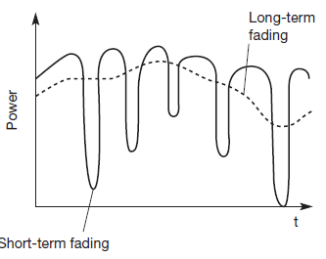
Fading
Quick changes in the received power are also called short-term fading.
Long-term fading, shown here as the average power over time.
Notes:
Doppler shift causes random frequency shifts.

Slide 36
Multiplexing
In telecommunications and computer networks
Multiplexing is a method by which multiple analog or digital signals are combined into one signal over a shared medium.
Multiplexing describes how several users can share a medium with minimum or no interference.
Multiplexing can be carried out in four dimensions:
space, time, frequency, and code
Notes:
Many users (car drivers) use the same medium (the highways) with hopefully no interference (i.e., accidents).
different cars use the same medium (i.e., the same lane) at different points in time (time division multiplexing).

Slide 37
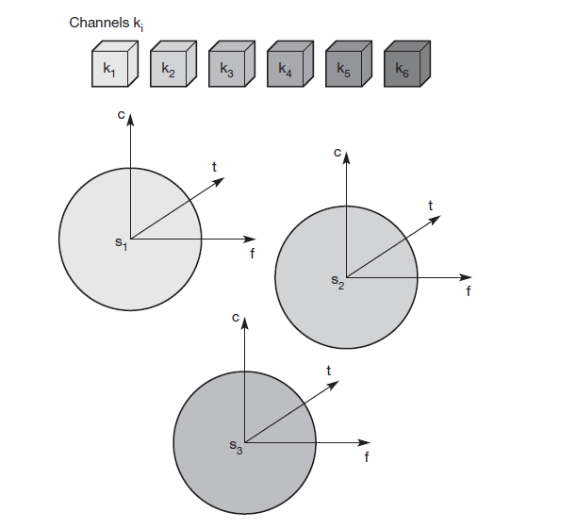
SDM : Space Division Multiplexing
Space is represented via circles indicating the interference range.
The space between the interference ranges is called guard space.
In wireless transmission, SDM implies a separate sender for each communication channel with a wide enough distance between senders.
Waste of space, principle used by the old analog telephone system.

Slide 38
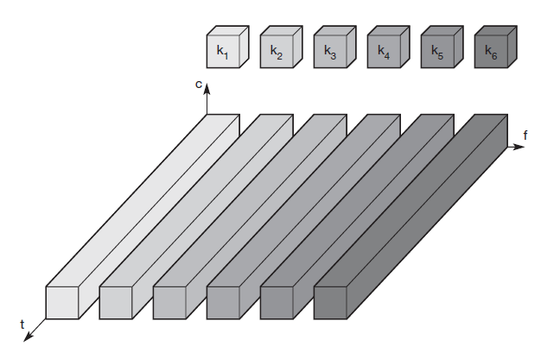
Frequency Division Multiplexing
Frequency division multiplexing (FDM) describes schemes to subdivide the frequency dimension into several non-overlapping frequency bands.
Guard spaces are needed to avoid frequency band overlapping (also called adjacent channel interference).
Scheme is used for radio stations within the same region, where each radio station has its own frequency.
Radio stations broadcast 24 hours a day, mobile communication typically takes place for only a few minutes at a time.
Assigning a separate frequency for each possible communication scenario would be a tremendous waste of (scarce) frequency resources.
Notes:
Senders using a certain frequency band can use this band continuously.

Slide 39
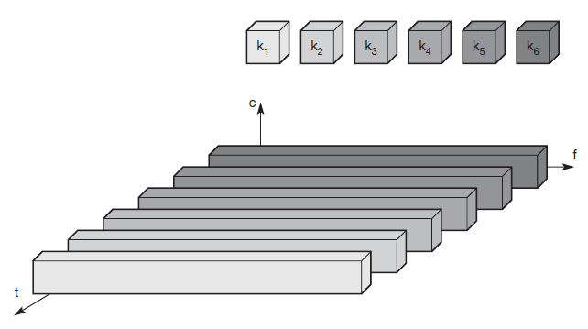
Time Division Multiplexing
Flexible multiplexing scheme for typical mobile communications is time division multiplexing (TDM).
Channel ki is given the whole bandwidth for a certain amount of time, i.e., all senders use the same frequency but at different points in time.
Guard spaces, represent time gaps.
If two transmissions overlap in time, this is called co-channel interference.

Slide 40
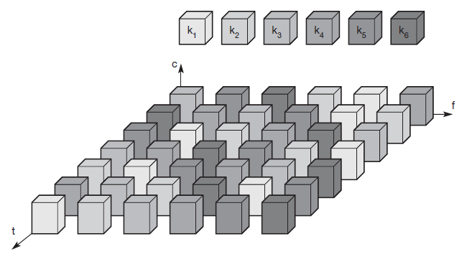
Time and Frequency Division Multiplexing (Used by GSM)

Slide 41
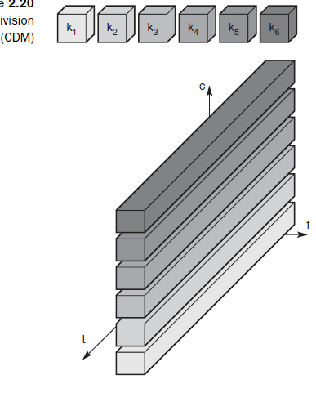
Code division multiplexing (CDM)
Separation is now achieved by assigning each channel its own ‘code’, guard spaces are realized by using codes with the necessary ‘distance’ in code space, e.g., orthogonal codes.
CDM for wireless transmission is that it gives good protection against interference and tapping.
Receiver is highly complex.
Notes:
Receiver has to know the code and must separate the channel with user data from the background noise composed of other signals and environmental noise.
Additionally, a receiver must be precisely synchronized with the transmitter to apply the decoding correctly.

Slide 42
Modulation Techniques
g(t) = At cos(2π ftt + φt) Signal Representation
amplitude At, frequency ft, and phase φt which may be varied in accordance with data or another modulating signal.
Digital modulation : digital data (0 and 1) is translated into an analog signal (baseband signal). Required if digital data has to be transmitted over a medium that only allows for analog transmission.
In wireless networks, digital transmission cannot be used.
The binary bit-stream has to be translated into an analog signal first.
Schemes used for this translation are:
amplitude shift keying (ASK)
frequency shift keying (FSK)
phase shift keying (PSK).
digital modulation translates a 1 Mbit/s bit-stream into a baseband signal with a bandwidth of 1 MHz.
In wireless transmission, an analog modulation that shifts the center frequency of the baseband signal generated by the digital modulation up to the radio carrier is needed

Slide 43
why this baseband signal cannot be directly transmitted in a wireless system?
Brain Storming

Slide 44
Reasons
Antennas: An antenna must be the order of magnitude of the signal’s wavelength in size to be effective. For the 1 MHz signal in the example this would result in an antenna some hundred meters high.
Frequency division multiplexing: Using only baseband transmission, FDM could not be applied. Analog modulation shifts the baseband signals to different carrier frequencies. The higher the carrier frequency, the more bandwidth that is available for many baseband signals.
Medium characteristics: Path-loss, penetration of obstacles, reflection, scattering, and diffraction –depend heavily on the wavelength of the signal.
Depending on the application, the right carrier frequency with the desired characteristics has to be chosen.

Slide 45
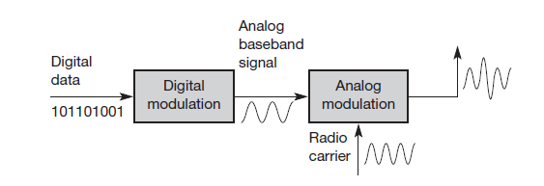
Modulation : Radio Transmitter for digital Data

Slide 46
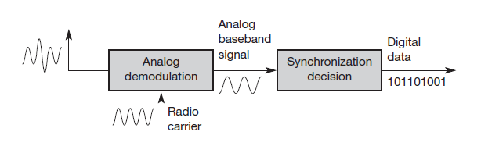
Demodulation and data reconstruction in a receiver

Slide 47
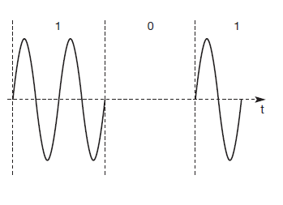
Amplitude shift keying (ASK), the most simple digital modulation scheme.
The two binary values, 1 and 0, are represented by two different amplitudes.
This simple scheme only requires low bandwidth, but is very susceptible to interference.
Effects like multi-path propagation, noise, or path loss heavily influence the amplitude.

Slide 48
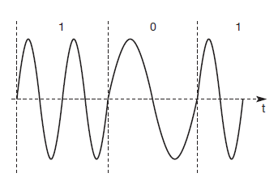
Binary FSK (BFSK)
One frequency f1 to the binary 1 and another frequency f2 to the binary 0.
To implement FSK is to switch between two oscillators, one with the frequency f1 and the other with f2, depending on the input.

Slide 49
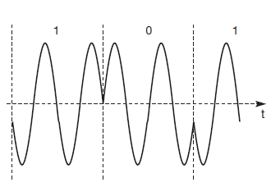
Phase shift keying (PSK)
Phase shift of 180° or π as the 0 follows the 1.
Shifting the phase by 180° each time the value of data changes, is also called binary PSK (BPSK).
To receive the signal correctly, the receiver must synchronize in frequency and phase with the transmitter. This can be done using a phase lock loop (PLL).

Slide 50
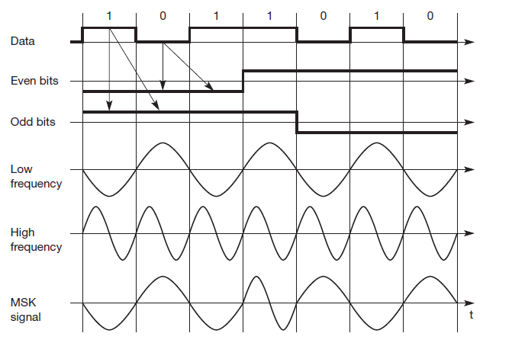
Advanced frequency shift keying
MSK is basically BFSK without abrupt phase changes.
data bits are separated into even and odd bits, the duration of each bit being doubled.
The scheme also uses two frequencies: f1, the lower frequency, and f2, the higher frequency, with f2 = 2f1.
if the even and the odd bit are both 0, then the higher frequency f2 is inverted (i.e., f2 is used with a phase shift of 180°); ● if the even bit is 1, the odd bit 0, then the lower frequency f1 is inverted.
if the even bit is 0 and the odd bit is 1, as in columns 1 to 3, f1 is taken without changing the phase,
if both bits are 1 then the original f2 is taken.
Notes:
data bits are separated into even and odd bits, the duration of each bit being doubled. The scheme also uses two frequencies: f1, the lower frequency, and f2, the higher frequency, with f2 = 2f1.
if the even and the odd bit are both 0, then the higher frequency f2 is inverted (i.e., f2 is used with a phase shift of 180°); ● if the even bit is 1, the odd bit 0, then the lower frequency f1 is inverted.

Slide 51
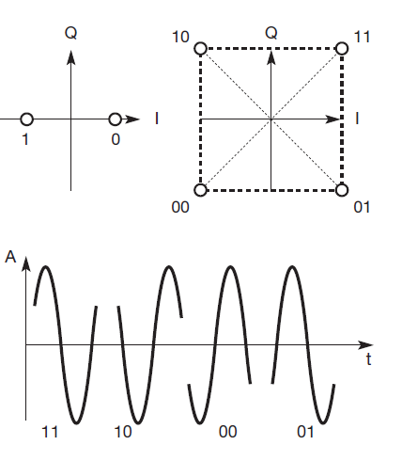
Advanced phase shift keying
QPSK (and other PSK schemes)
can be realized in two variants.
The phase shift can always be relative to a reference signal (with the same frequency).
If this scheme is used, a phase shift of 0 means that the signal is in phase with the reference signal.
A QPSK signal will then
exhibit a phase shift of 45° for the data 11, 135° for 10, 225° for 00, and 315° for 01 – with all phase shifts being relative to the reference signal.
Notes:
The transmitter ‘selects’ parts of the signal as shown in Figure 2.28 and
concatenates them. To reconstruct data, the receiver has to compare the incoming
signal with the reference signal. One problem of this scheme involves producing a reference signal at the receiver. Transmitter and receiver have to be synchronized very often, e.g., by using special

Slide 52
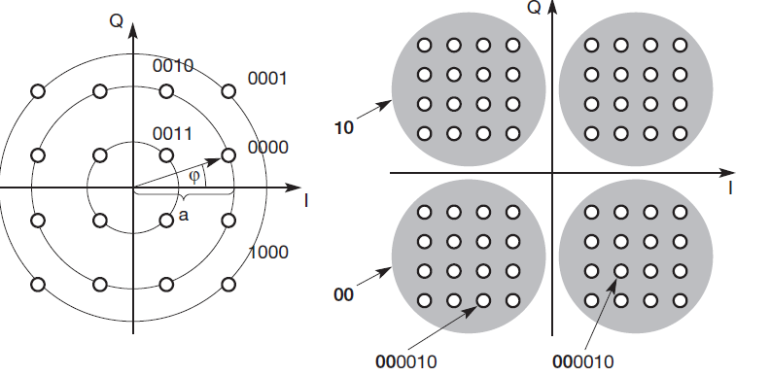
Quadrature amplitude modulation (QAM)
Three different amplitudes and 12 angles are combined coding 4 bits per phase/amplitude change.
The more ‘points’ used in the phase domain, the harder it is to separate them.

Slide 53
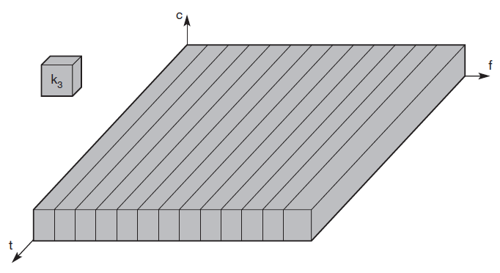
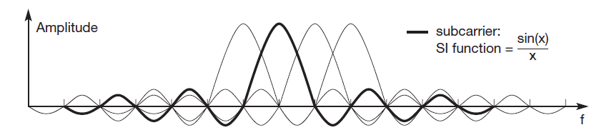
Multi-carrier modulation
MCM has good ISI mitigation property.
Higher bit rates are more vulnerable to ISI.
MCM splits the high bit rate stream into many lower bit rate streams.
Each stream is sent using an independent carrier frequency.
If, for example, n symbols/s have to be transmitted, each subcarrier transmits n/c symbols/s with c being the number of subcarriers.
One symbol could, for example represent 2 bit as in QPSK
Notes:
Using this scheme, frequency selective fading only influences some subcarriers, and not the whole signal – an additional benefit of MCM.

Slide 54
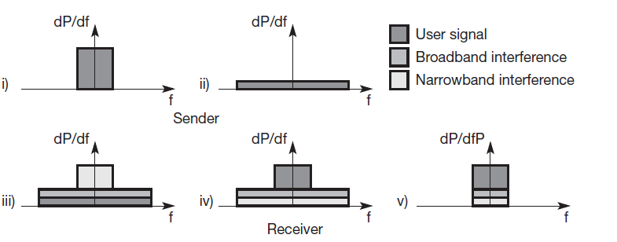
Spread Spectrum
Spread spectrum techniques involve spreading the bandwidth needed to transmit data.
Advantages:
1. Resistance to narrowband interference.

Slide 55
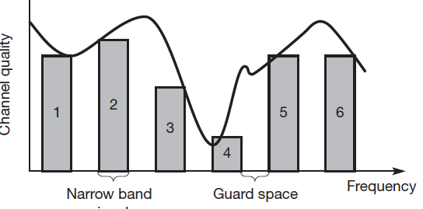
Narrow Band Interference without spread spectrum
Six different channels use FDM for multiplexing, each channel has its own narrow frequency band for transmission.
Between each frequency band a guard space is needed to avoid adjacent channel interference.
Channel quality also changes over time – the diagram only shows a snapshot at one moment.
Narrowband interference destroys the transmission of channels 3 and 4.
Notes:
All in all, communication may be very difficult using such narrowband signals.
Depending on receiver characteristics, channels 1, 2, 5, and 6 could be received while the quality of channels 3 and 4 is too bad to reconstruct transmitted data.

Slide 56
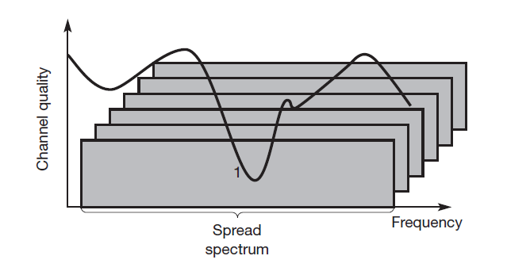
Spread Spectrum to avoid Narrow Band Interference
All narrowband signals are now spread into broadband signals using the same frequency range.
Application shows the tight coupling of CDM and spread spectrum to recover signal at the receiver.
One disadvantage is the increased complexity of receivers that have to despread a signal.
Another problem is ,Large frequency band is needed due to the spreading of the signal.

Slide 57
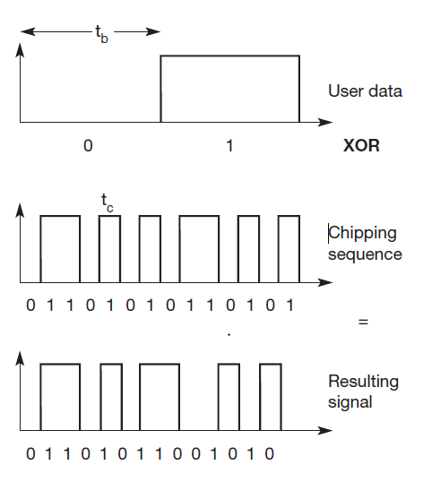
Spreading the spectrum can be achieved in two different ways
Direct sequence spread spectrum (DSSS): System take a user bit stream and perform an (XOR) with a so-called chipping sequence.

Slide 58
DSSS
Result is either the sequence 0110101 (if the user bit equals 0) or its complement 1001010 (if the user bit equals 1).
While each user bit has a duration tb, the chipping sequence consists of smaller pulses, called chips, with a duration tc.
If the chipping sequence is generated properly it appears as random noise: this sequence is also sometimes called pseudo-noise sequence. The spreading factor s = tb/tc determines the bandwidth of the resulting signal.
If the original signal needs a bandwidth w, the resulting signal needs s·w after spreading.

Slide 59
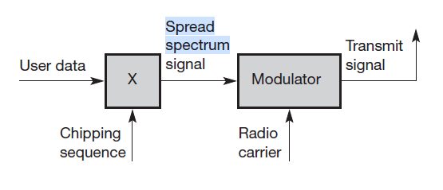
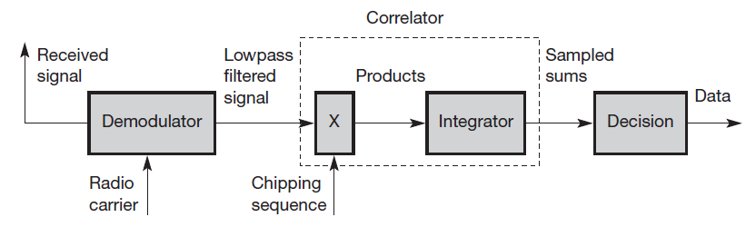
DSSS Transmitter and Receiver

Slide 60
Challenges in DSSS
Receiver has to know the chipping sequence.
Sequences at the sender and receiver have to be precisely synchronized because the receiver calculates the product of a chip with the incoming signal.
Chip Sequence:
Sending the user data 01 and applying the 11-chip Barker code 10110111000 results in the spread ‘signal’ 011011100001001000111.
There are several paths and signals due to multi path propagation, so there is need of rake receiver.
Notes:
Rake receiver – to counter the effects of multipath fading

Slide 61
Frequency hopping spread spectrum (FHSS)
Total available bandwidth is split into many channels of smaller bandwidth plus guard spaces between the channels.
Transmitter and receiver stay on one of these channels for a certain time and then hop to another channel.
The pattern of channel usage is called the hopping sequence, the time spend on a channel with a certain frequency is called the dwell time.

Slide 62
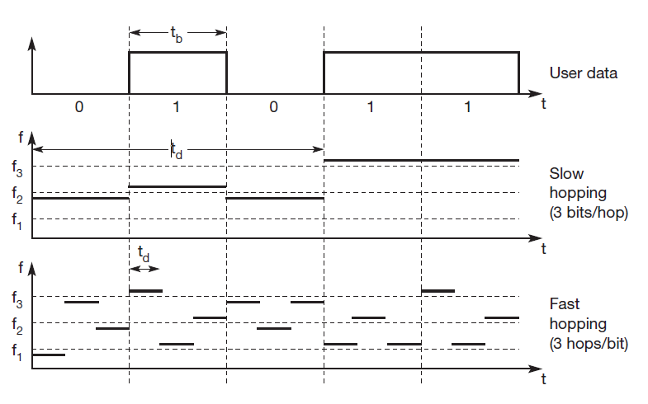
FHSS: Slow and Fast

Slide 63
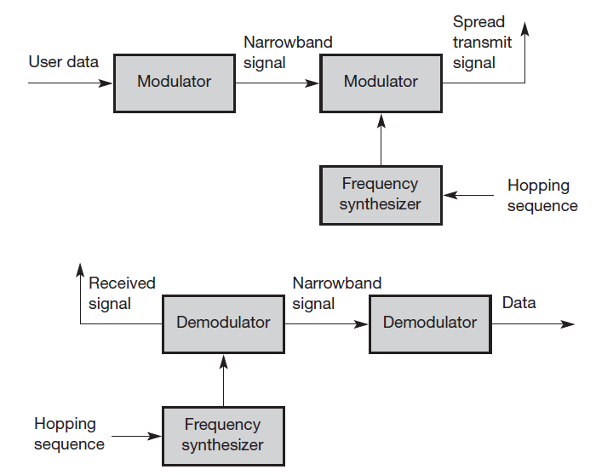
FHSS: Transmitter & Receiver

Slide 64
DSSS V/s FHSS
FHSS systems only use a portion of the total band at any time, while DSSS systems always use the total bandwidth available.
DSSS systems are more resistant to fading and multi-path effects.
DSSS signals are much harder to detect – without knowing the spreading code, detection is virtually impossible.
If each sender has its own pseudo-random number sequence for spreading the signal (DSSS or FHSS), the system implements CDM.

Slide 65
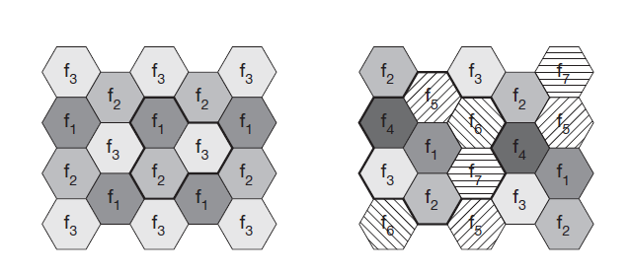
Cellular Systems – Frequency Reuse
Cellular systems for mobile communications implement SDM.
Each transmitter, called a base station, covers a certain area, a cell.
In Mobile telecommunication systems, a mobile station within the cell around a base station communicates with this base station and vice versa.
Notes:
Why so many base stations are installed? Why not less BS which are powerful?

Slide 66
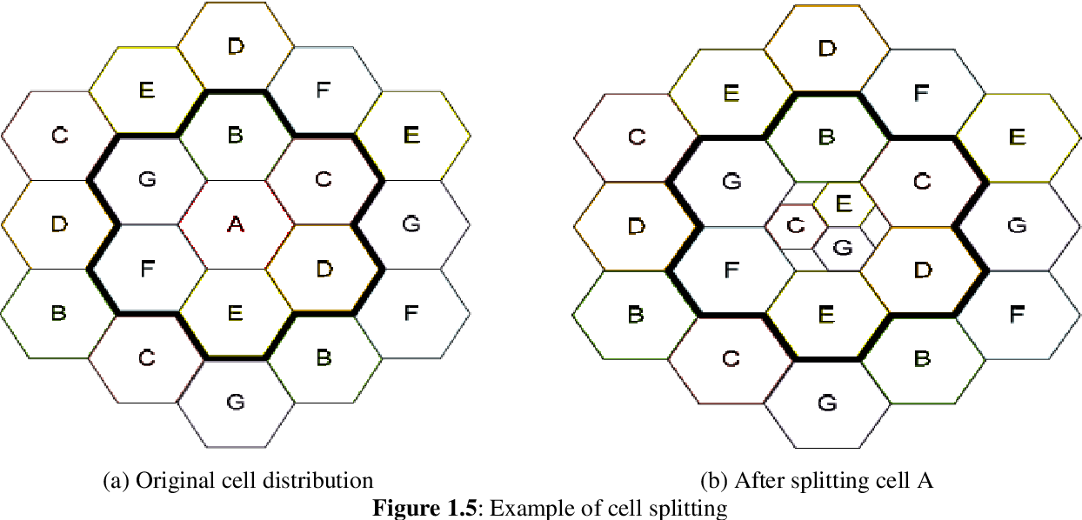
Cell Splitting
Cell splitting is the process of subdividing a congested cell into smaller cells, each with its own base station and a corresponding reduction in antenna height and transmitter power.
Cell splitting increases the capacity of a cellular system since it increases the number of times that channels are reused.

Slide 67
Advantages of Small Cells
Higher capacity: Implementing SDM allows frequency reuse. As most mobile phone systems assign frequencies to certain users (or certain hopping patterns), this frequency is blocked for other users. But frequencies are a scarce resource and, the number of concurrent users per cell is very limited. Huge cells do not allow for more users.
Less transmission power: A receiver far away from a base station would need much more transmit power than the current few Watts.
Local interference only: With small cells, mobile stations and base stations only have to deal with ‘local’ interference.
Robustness: Cellular systems are decentralized and so, more robust against the failure of single components.
Notes:
If one transmitter is far away from another, i.e., outside the interference range, it can reuse the same frequencies.
On the contrary, they are limited to less possible users per km2. This is also the reason for using very small cells in cities where many more people use mobile phones.

Slide 68
Disadvantages of Small Cells
Infrastructure needed: Cellular systems need a complex infrastructure to connect all base stations.
Handover needed: The mobile station has to perform a handover when changing from one cell to another. Depending on the cell size and the speed of movement, this can happen quite often.
Frequency planning: To avoid interference between transmitters using the same frequencies, frequencies have to be distributed carefully.
Notes:
This includes many antennas, switches for call forwarding, location registers to find a mobile station etc, which makes the whole system quite expensive.

Slide 69
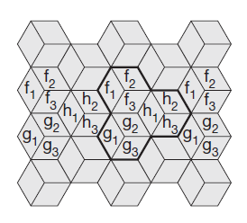
Channel Allocation-Cellular System with 3 Cell Cluster
Fixed Channel Allocation
Dynamic Channel Allocation
Borrowing Channel Allocation
All cells within a cluster use disjointed sets of frequencies. One cell in the cluster uses set f1, another cell f2, and the third cell f3.

Slide 70
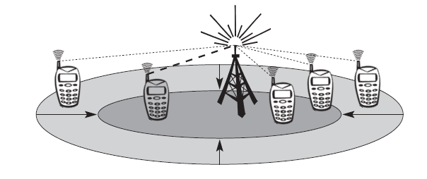
Cellular systems using CDM
Users are separated through the code they use, not through the frequency.
Cell size depends on the current load.
CDM cells are commonly said to ‘breathe’.
Cell can cover a larger area under a light load, it shrinks if the load increases.

Slide 71
Thank You

